Slide 1


Strengthening Security & Compliance: The Case for a
GRC Plan
12.03.2024
Presented by Risk Management Officers:
Toni Small
Bryan Thomas
Stacey Sing-Tucker

Slide 2


TABLE OF CONTENTS
01.
04.
Meet the Team
Adopting a New Framework
02.
05. - 06.
Goals of the GRC Program
What We are Facing
03.
07.
Threat Landscape & Risk Appetite
GRC Timeline

Slide 3




01.
MEET THE TEAM
Risk Management Officers
Toni Small
Bryan Thomas
Stacey Sing-Tucker
Notes:
SLIDE 1 – Meet the Team
- Toni Small, Bryan Thomas, and Stacey Sing-Tucker are dedicated Risk Management Officers.
- Where we have the privilege of leading GlobalTech’s cybersecurity efforts.
- Together, we crafted a comprehensive Governance, Risk, and Compliance (GRC) plan.
- to safeguard sensitive healthcare data.
- Their expertise will guide Globaltech to ensure secure, innovative imaging software.
- That can enhance operational efficiency and patient care for many health organizations.

Slide 4




02.
GOALS OF THE GRC PROGRAM
Align with Organizational Objectives
Manage Risks Effectively
Ensure Regulatory Compliance
Enhance Decision-Making
Protect Data and Assets
Improve Operational Efficiency
Foster a Compliance Culture
Enable Scalability
Notes:
SLIDE 2 – Goals of the GRC program “A GRC program ensures alignment with business goals, manages risks, meets regulatory requirements, protects assets, improves efficiency, supports scalability, and fosters a culture of compliance to enhance decision-making.”
Scalability in GRC ensures processes adapt to growth, complexity, and requirements without losing effectiveness.

Slide 5



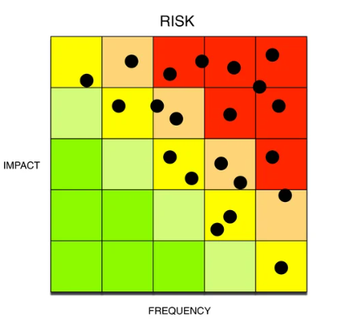


03.
GLOBALTECH CURRENT THREATS
Cybersecurity Threats
Insider Threats
Regulatory & Compliance Risks
Data Breaches
Ransomware Attacks
Phishing and Social Engineering
Employee or Contractor Risks
Lack of Security Awareness
HIPPA Violations
Data Localization and Privacy Laws
Third Party Risks
Financial Threats
Vendor and Supply Chain Vulnerabilities
Software Dependencies
Cost of Cybersecurity Measures
Legal Liabilities and Fines
Operational and Business Continuity Risks
Technological Evolution & Obsolescence
Downtime and Service Disruptions
Scalability Challenges
Rapid Technological Changes
Interoperability Issues
Risk Tolerance:
Low to Medium Risk
Low Tolerance
Data Security
Patient privacy
Regulatory compliance
Medium Tolerance
Innovation for
advancing technologies
Notes:
“Our company faces various threats, including cybersecurity risks like data breaches, ransomware, and phishing. Insider threats, such as employee mistakes and lack of awareness, are critical. Regulatory risks involve HIPAA violations and privacy laws. Third-party risks stem from vendor vulnerabilities and software dependencies. Financial threats include cybersecurity costs and legal fines, while operational risks involve downtime and scalability challenges. Lastly, rapid technological changes and interoperability issues add complexity.”
Risk Appetite: Our organization maintains a low-risk tolerance for patient safety and data privacy, focusing on secure, reliable care and robust data protection. We accept moderate risk when exploring enhancements in medical technologies and treatments, understanding their potential to drive better outcomes and foster growth. Risk appetite Chart: https://www.fairinstitute.org/blog/a-fair-view-of-risk-appetite-part-1

Slide 6
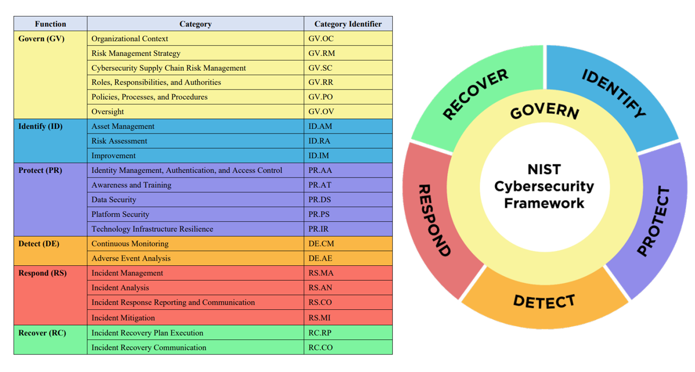
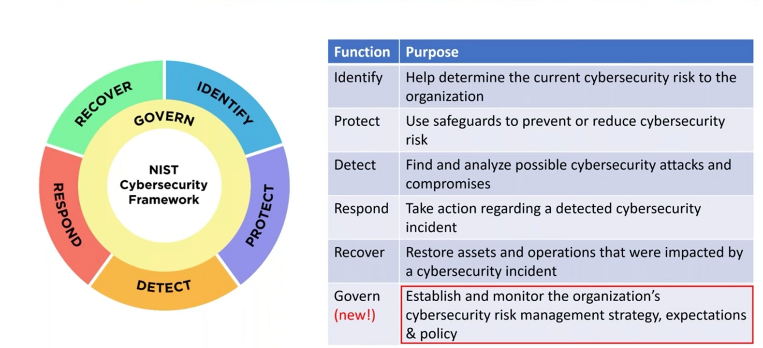
Adopting a New Framework
04.
NIST Cybersecurity Framework 2.0 (2024)
The NIST CSF 2.0 aligns with GlobalTech’s mission by:
Addressing critical healthcare cybersecurity threats
Ensuring data security, compliance, and operational resilience
Addressing ransomware, insider threats, vendor risks, and regulatory changes.
Enabling secure innovation to enhance patient care and efficiency.

Slide 7

05.
WHAT WE ARE CURRENTLY FACING
RISK
MITIGATION
WHY?
Implementation & MONITORING
Can be accessed easily by unauthorized user
Misplaced or lost by staff
Taken by unauthorized user
BitLocker USB
Used ONLY with company computers
No personal devices USB devices
To protect against sensitive data that is lost, stolen or attempted to be accessed by unauthorized users
BitLocker USB distribution
Will not work if not a company computer
Sensitive client data on a USB
Manage identities and credentials for users, services, and hardware.
Users, services, and hardware are authenticated
Create a privilege policy
Require least-privilege policies to limit access to prevent breaches, financial loss, and reputational harm.
Setup the Access Control Lists
Regular weekly checks on Access Lists permission
Conduct quarterly policy reviews
Access privileges being implemented on an Ad Hoc basis
Employees can receive unauthorized access to data or security
Develop incident response plan
Keep software up to date
Data Backups
Accurate training logs reduce cybersecurity risks caused by employee actions.
Set deadlines and timelines for employee security training completion
Non-completion of training will result in , log-in will be locked until training is complete
Employee security awareness training logs files were corrupted
Employee security awareness training logs files were corrupted
No corporate data acceptable uses policies even though a BYOE
Personal devices connecting to external networks risk virus infections.
Stolen devices outside the workplace expose sensitive company data.
Create a BYOE policy
Limit access to specific sites
Ensure the use of strong passwords and MFA
To protect company info and sensitive customer data from being misused from non-company devices
IT and SOC monitor networks daily to ensure secure communication.
Notes:
Vulnerability #1:
Sensitive client data on USBs is at risk of being accessed by unauthorized users if misplaced, lost, or stolen. To mitigate this, we’re implementing BitLocker encryption, ensuring USBs are only compatible with company devices, and prohibiting personal USBs. This protects against unauthorized access and secures sensitive data, even if the USB is lost. Implementation includes distributing BitLocker-enabled USBs that won’t function on non-company computers.
Vulnerability #2:
Implementing access privileges on an ad hoc basis risks employees gaining unauthorized access to sensitive data or systems. To mitigate this, we’ll manage identities, authenticate users and devices, and implement a least-privilege policy to minimize excessive permissions. This reduces security breaches, financial loss, and reputational damage. Implementation includes setting up Access Control Lists, conducting weekly permission checks, and quarterly policy reviews to stay aligned with industry standards and emerging threats.

Slide 8
06.
WHAT WE ARE CURRENTLY FACING
RISK
MITIGATION
WHY
Implementation & MONITORING
Active user accounts 30 days beyond employment separation
Allows former employees continued access to company’s data and data theft of employees or customer information
Disable separated employees' accounts and building access immediately.
Reset and erase personal data from all applicable devices.
To protect against sensitive data that is lost, stolen or attempted to be accessed by unauthorized users
Monitor data log computers-ins
Track IP addresses
Eliminate the use of generic accounts and enforce unique user accounts with strong authentication methods.
Generic accounts can lead to unauthorized access and accountability issues, making it difficult to trace actions back to individual users.
Audit and eliminate generic accounts.
Review logs for unauthorized access.
Conduct regular access reviews and remove inactive accounts.
Monitor for new generic accounts.
Generic Accounts stored in database
Employees can receive unauthorized access to data or security
Proper encryption protects sensitive data from interception and unauthorized access, ensuring compliance with data protection regulations.
Require SSL for login servers to secure connections.
Upgrade encryption to industry-standard algorithms.
Regularly audit and monitor encryption
Login encryption settings not properly configured
Create the risk for employees to have unauthorized access to company system
Implement strong encryption protocols (e.g., AES-256) for user login credentials and enforce the use of HTTPS for all login communications.
Non-Critical Patches Implemented Without Being Tested
Allowing untested patches to disrupt business continuity
Establish a formal patch management process that includes testing all patches in a controlled environment before deployment.
Untested patches risk vulnerabilities, system disruptions, downtime, and potential security breaches.
Test patches in a staging environment before deployment.
Implement a patch management policy with clear testing protocols.
Regularly evaluate and improve the patch management process.

Slide 9











2024-25 GRC Timeline
Define, Assess, Develop, Implement, Train, Pilot, Monitor, Refine, Repeat.
Phase 1
Foundational Assessments
0-6 months
Phase 3
Tool Integration
9-12 months
Phase 5
GRC Trial Implementation 15-18 months
Define Scope / Current State Assessment (1m)
Stakeholder Engagement (1m)
Adopting NIST CSF Framework (2m)
Adopting the NIST RMF (1m)
Conduct a Risk Assessment (1m)
Research applicable GRC tools (1m)
Develop Implementation of GRC tool (2m)
Define Pilot scope
Implement GRC components
Monitor and acquire feedback(1m)
Employee & Stakeholders feedback & Engagement
Employee Incentives Plan
Create GRC Archived Documentation
1
3
5
2
4
Phase 2
Policy Development
6-9 months
Phase 4
Educational Training
12-15 months
Acceptable Use Policy (AUP)
Access Control Policy
Incident Response Policy
Data Protection and Privacy Policy
Password Management Policy
Network Security Policy
Bring Your Own Device (BYOD) Policy
Employee Security Awareness and Training Policy
Patch Management Policy
Comprehensive GRC Training
Compliance Management Training
Incidence Response Training
Security Awareness Training

Slide 10











NIST RESOURCES AND LINKS
NIST RMF
NIST CONTROLS
Categorize, select, implement, assess, authorize, monitor: managing cybersecurity risks.
Categories to ensure cybersecurity standards are met
NIST CSF 2.0
Risk Severity Chart
Identify, protect, detect, respond, recover: an adaptable framework for cybersecurity.
Ranks risks by likelihood and impact: low, medium, high, critical.

Slide 11




CYBERSECURITY BREACH RESOURCES
Starbucks
UCLA Hospital
Ransomware Attack Third Party Vendor vulnerability
November 2024
Data Breach
Privilege Creep/HIPAA violation
Various dates from 2005-2009
Change Healthcare
Veteran Affairs
Ransomware Attack No MFA set-up February 2024
Data Breach USB devices stolen October 2017

Slide 12
Thank You!
Notes:
Adopting the NIST 2.0 Cybersecurity Framework and a robust GRC program is essential for safeguarding sensitive healthcare data, meeting regulatory compliance, and reducing security risks. This framework ensures a proactive approach to managing cyber threats while aligning with industry best practices. By investing in these tools, we protect patient trust, avoid costly breaches, and position the company as a leader in healthcare security

